Slide 1

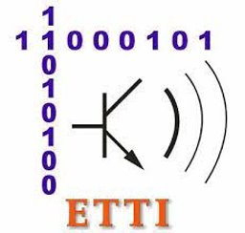

Run-length Encoding and decoding performance Analysis on big data files
Student:
Răzvan-Adrian Negulescu
Coordinators:
Călin Bîră Radu Hobincu Gheorghe Ștefan

Slide 2

Introduction – What is Run-Length Encoding?
Run Length Encoding(RLE) is one of the oldest algorithms for data-compression available
It compresses by looking at the data for repetitions of the same character in a row and stores the amount and the respective character as target-data
Unfortunately, it only compresses within strict and special cases. Outside of these cases, it increases the data-size, even doubles the size in worst cases compared to the original input
Common formats for Run-Length Encoded data include Truevision TGA, PackBits (by Apple used in MacPaint), PCX and ILBM. The International Telecommunication Union also describes a standard to encode run-length color for fax machines, known as T.45

Slide 3
Introduction – How does the code works?
INPUT DATA
Matrix width (integer)
Matrix height (integer)
Number of different characters (integer)
The used letters (char array)
GENERATE RANDOM INPUT DATA TO BE ENCODED
Create a random matrix (Matrix width * Matrix height values), that will be used as input data
Save the input data in a text file (input_data.txt)
RLE DECODING
Function that extracts the characters from the encoded file (encoded_data.txt) and save them in a char array.
Transform an array of consecutive char digits (‘1’,’2’,’3’) in an integer number (123)
Write the decoded data in a text file (decoded_data.txt)
RLE ENCODING
Function looks at the data for repetitions of the same character in a row and stores the number of repetitions and the respective character
Write the encoded data in a text file (encoded_data.txt)
PERFORMANCE ANALISYS
Check the execution time of encoding and decoding for unoptimized and optimized code
Check the size of input data, encoded data and decoded data

Slide 4
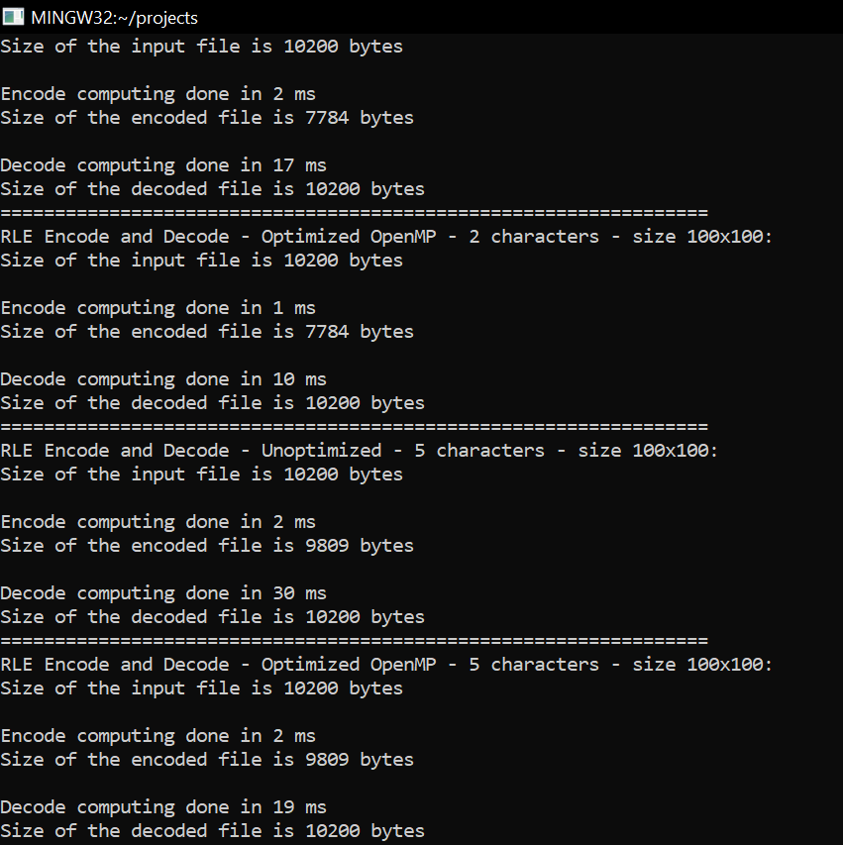
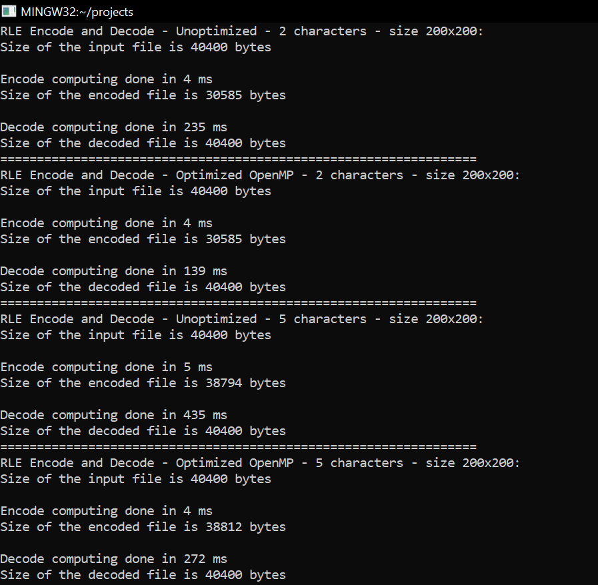
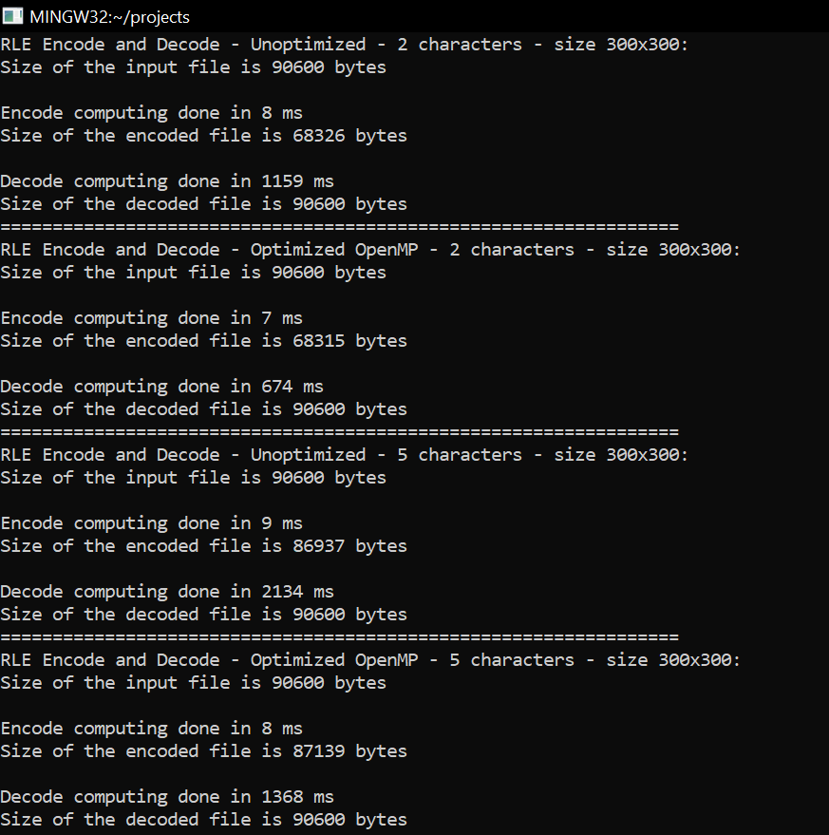
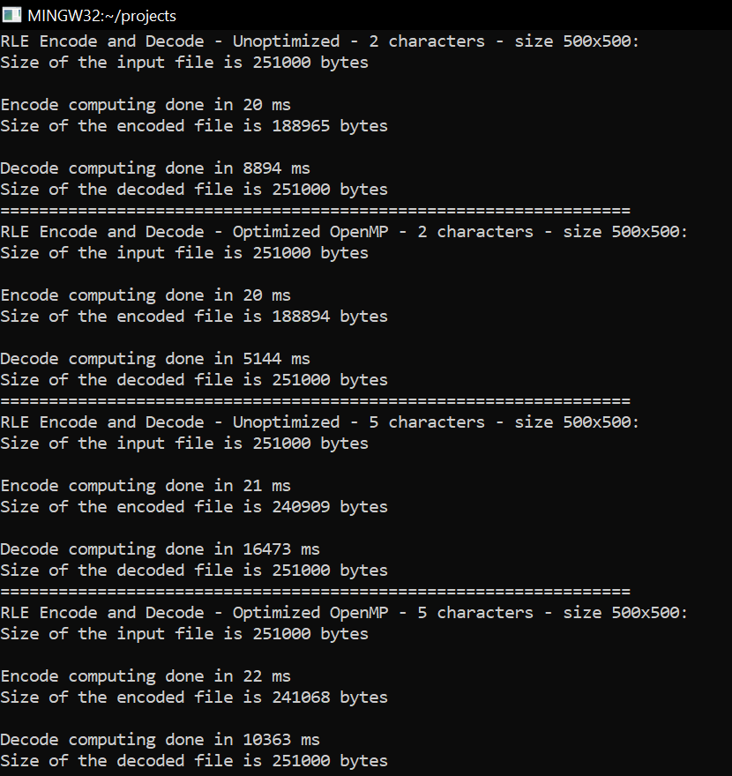
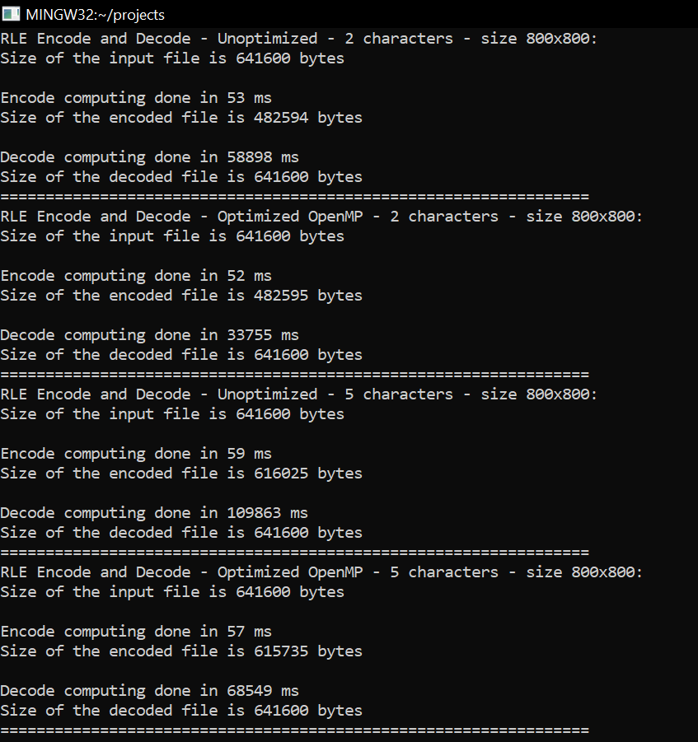
Results: No optimizations –o VS -O3 + OpenMP (makefile - console view)
Hardware
AMD Ryzen 7 5800H

Slide 5
Results: No optimizations –o VS -O3 + OpenMP (Summary)
Number of rows | Number of columns | Number of characters | Number of different letters | Encode time unoptimized [ms] | Decode time unoptimized [ms] | Encode time optimized [ms] | Decode time optimized [ms] | Initial size [KB] | Encoded size [KB] | Reduction in size [%]
100 | 100 | 10000 | 2 | 2 | 17 | 1 | 10 | 10.2 | 7.784 | 23.686
100 | 100 | 10000 | 5 | 2 | 30 | 2 | 19 | 10.2 | 9.809 | 3.833
200 | 200 | 40000 | 2 | 4 | 235 | 4 | 139 | 40.4 | 30.585 | 24.294
200 | 200 | 40000 | 5 | 5 | 435 | 4 | 272 | 40.4 | 30.585 | 24.294
300 | 300 | 90000 | 2 | 8 | 1159 | 7 | 674 | 90.6 | 68.315 | 24.597
300 | 300 | 90000 | 5 | 9 | 2134 | 8 | 1368 | 90.6 | 68.315 | 24.597
500 | 500 | 250000 | 2 | 20 | 8894 | 20 | 5144 | 25.1 | 188.965 | 24.715
500 | 500 | 250000 | 5 | 21 | 16473 | 22 | 10363 | 25.1 | 188.965 | 24.715
800 | 800 | 640000 | 2 | 53 | 58898 | 52 | 33755 | 641.6 | 482.594 | 24.782
800 | 800 | 640000 | 5 | 59 | 109863 | 57 | 68549 | 641.6 | 482.594 | 24.782

Slide 6
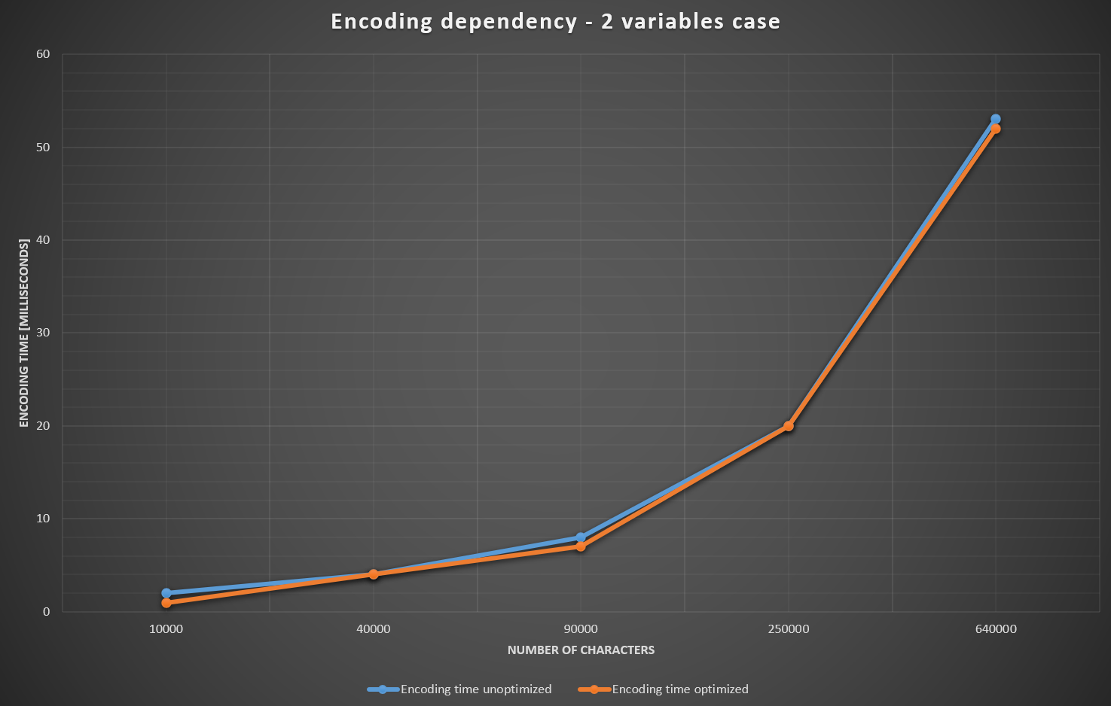
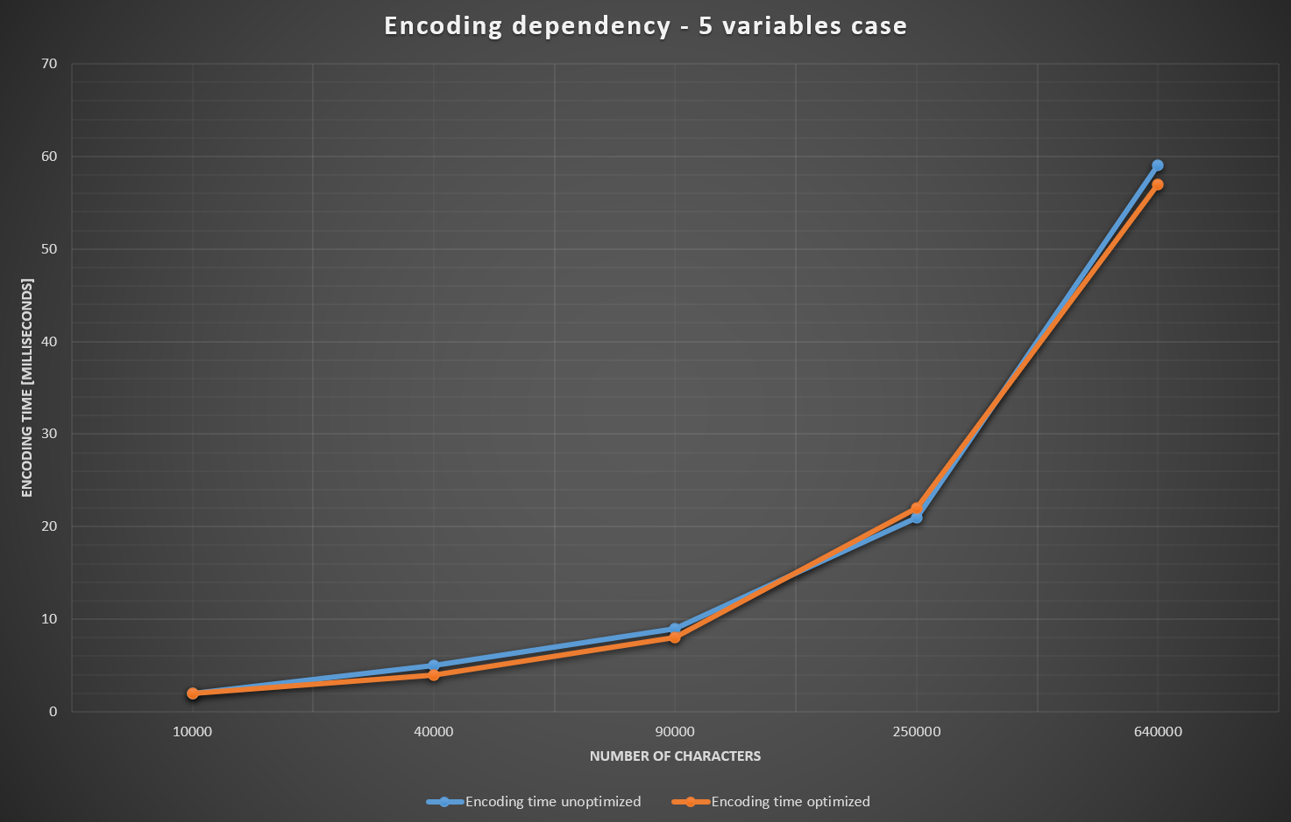
Encoding results: No optimizations –o VS -O3 + OpenMP (statistical view)

Slide 7
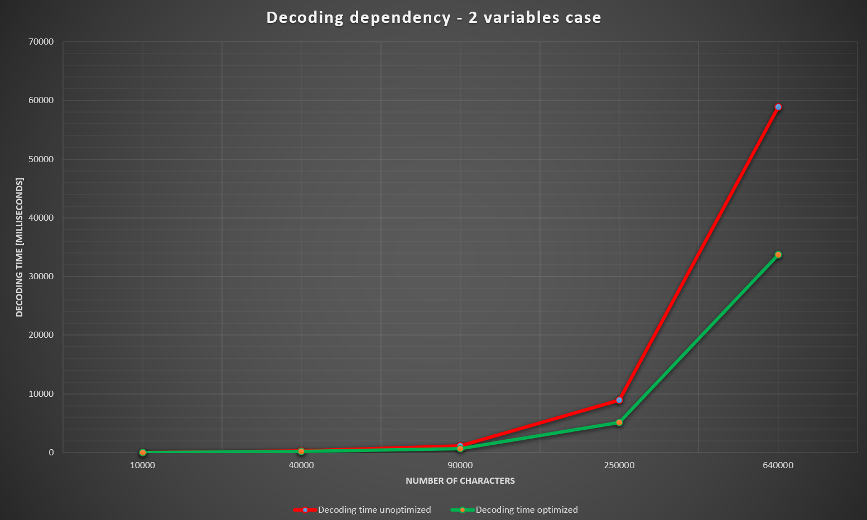
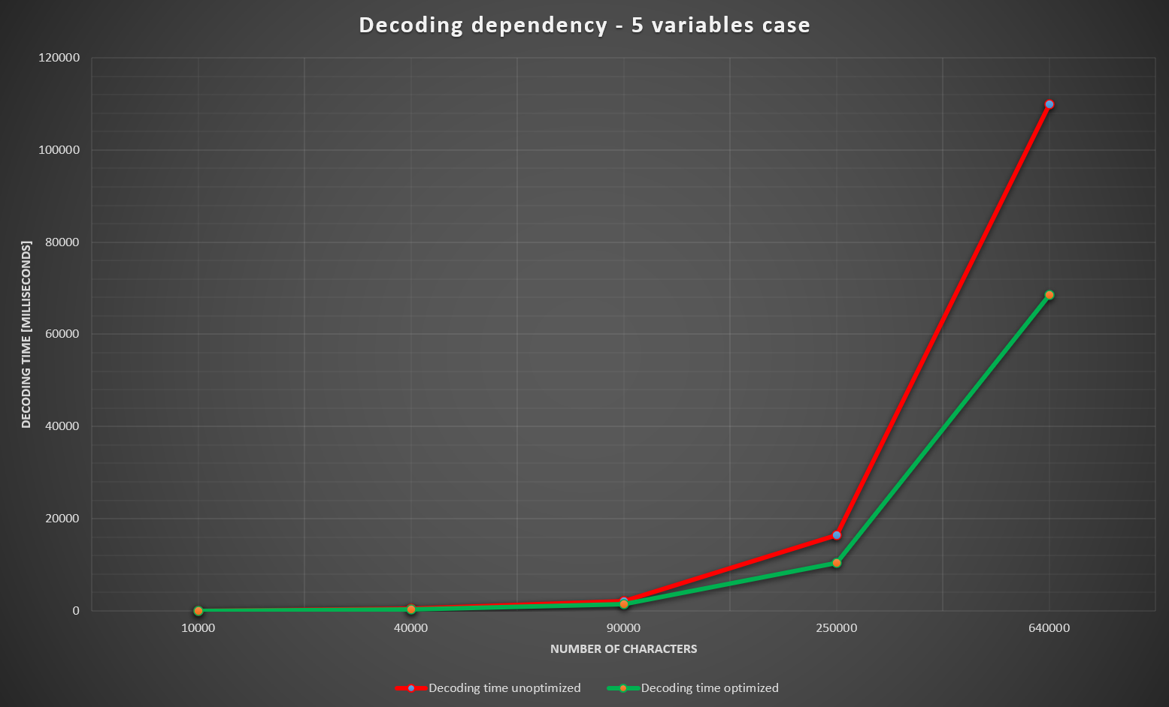
Decoding results: No optimizations –o VS -O3 + OpenMP (statistical view)

Slide 8



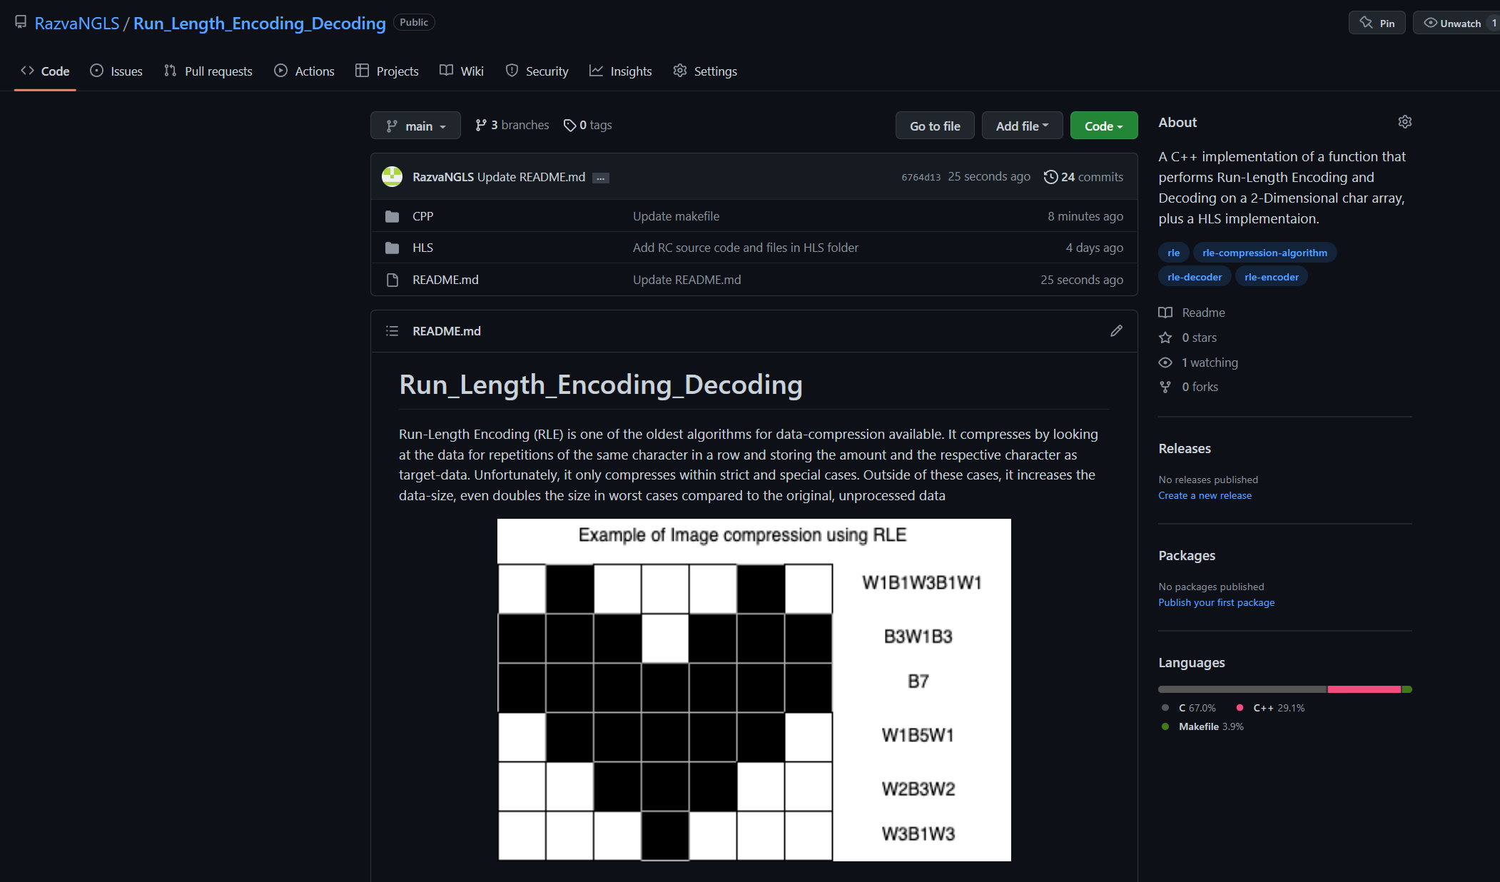
Software development
Git Repository: https://github.com/RazvaNGLS/Run_Length_Encoding_Decoding

Slide 9
Conclusion (comparison with existing methods)
All existing methods to implement a Run-Length encoding are using either a string of a small number of elements or a Python implementation of an image that only use two colors.
This method implements a function that replaces the image with a matrix of characters, each character representing a color.
In case there is only one occurrence of a character, other developers prefer to encode the target character, assigning it with 1 (“ab” -> “a1b1”).
I avoided this type of convention, to reduce the size of the encoded file.
Other methods don't include a decoding function.
Other methods don’t have a clear visualization of the time execution and memory.
The decoding function need optimizations to reduce the execution time under seconds range
The encoding function has a data compression rate of ~ 24%

Slide 10
Bibliography and resources:
Smile! You’re on RLE! Link: http://csbruce.com/cbm/transactor/pdfs/trans_v7_i06.pdf
Comparison Between (RLE And Huffman) Algorithms for Lossless Data Compression,
Dr. AMIN MUBARK ALAMIN IBRAHIM
Dr. MUSTAFA ELGILI MUSTAFA
Link: https://core.ac.uk/download/pdf/228547034.pdf
Run Length Encoding (RLE) Compression Algorithm in Python
Terrence Aluda
Link: https://www.section.io/engineering-education/run-length-encoding-algorithm-in-python/
https://stackoverflow.com/
https://q-viper.github.io/2021/05/24/coding-run-length-encoding-in-python/
https://www.csfieldguide.org.nz/en/chapters/coding-compression/run-length-encoding/
https://github.com/MichaelDipperstein/rle

Slide 11

Thank you!

